Slide 1
Python 101
logic, conditionals

Slide 2
last time
solving the pizza problem
improving UX in programming
using modules
functions

Slide 3
logic
What do we mean by logic / logical?
Notes:
absolute vital part of CS
consistency, rational

Slide 4
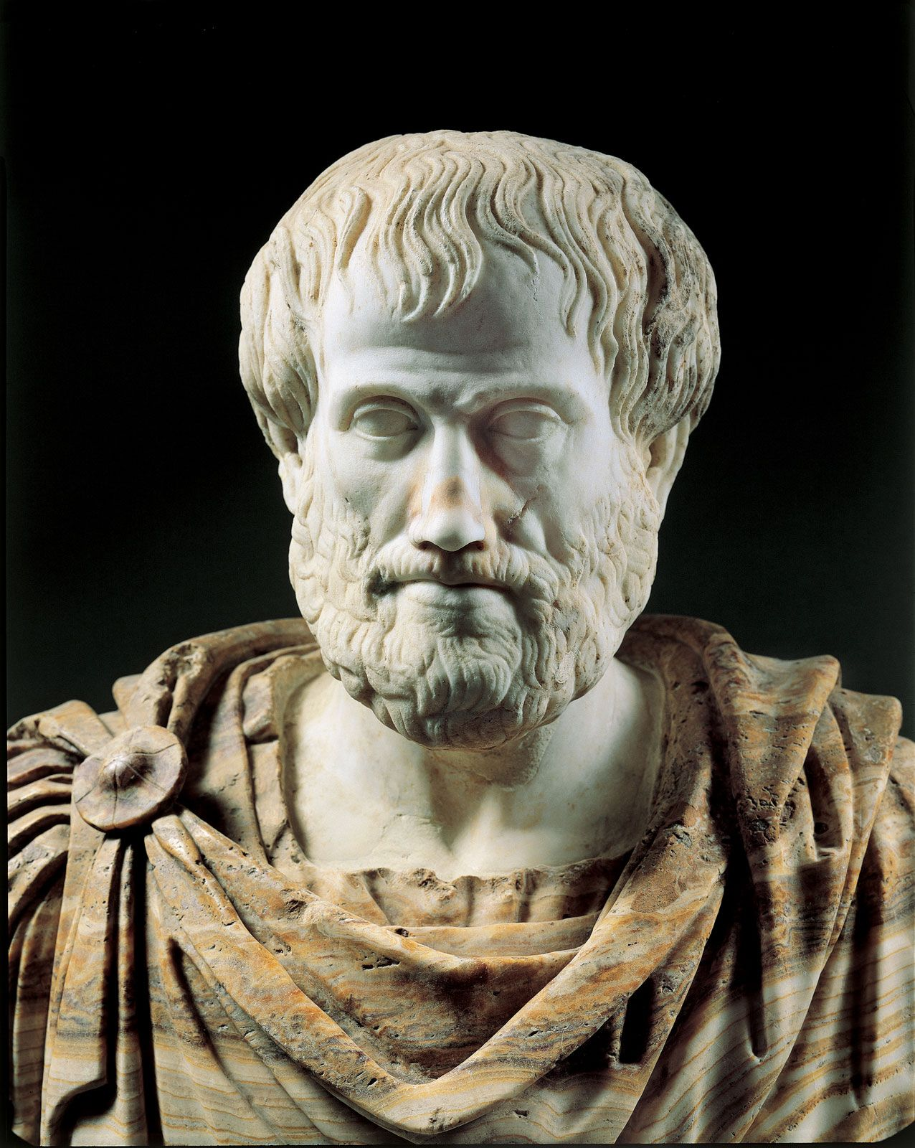
Notes:
goes back to Aristotle

Slide 5
correctness of inferences

Slide 6

Notes:
it basically means whether you lie or not when you
say a declarative sentence.

Slide 7
propositions
Notes:
a statement is a proposition
if:
it bears clear information
“truth value”, either T / F

Slide 8
Which of these are propositions?
It was raining.
The capital of Hungary is Budapest.
5 < 3
A teacher of our school is 40 years old.
The principal of our school is 50 years old.
Notes:
2, 3, 5

Slide 9
negation
Notes:
logical operators

Slide 10
Which proposition negates A?
Panni’s cat is black.
Panni’s cat is colorful.
Panni’s cat is not black.
Notes:
why is b not correct here?

Slide 11
negate the following statements
Every car in our street is an Opel.
There is a cat which is black.
Every road leads to Rome.
All of Kate’s drawings are beautiful.

Slide 12
truth tables, and / or

Slide 13
When are these propositions true?
It is raining and the sun is shining.
Béla got an A in Maths or Computer Science
R and S
M or C

Slide 14
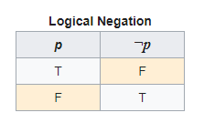

Slide 15
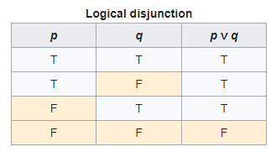

Slide 16
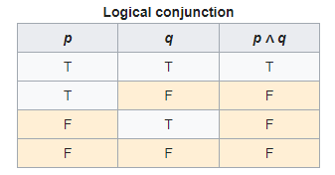

Slide 17
What’s the difference in terms of ‘truthness’ between these propositions?
José drinks or drives.
José either drinks or drives.
Notes:
second one is an XOR

Slide 18
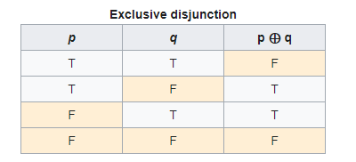

Slide 19
back to algorithms
Notes:
how did we model them?
(natural language)

Slide 20
pseudo code
Notes:
what does pseudo mean?
(not real, “almost”, “fake”)

Slide 21
bob’s fence problem
pseudo code
Program bob
var side: int
side := input()
output(side * 4)
End Program
python code
side = int(input())
print(side * 4)
Notes:
this is an example, no set rules

Slide 22
flowcharts
Notes:
how does it work

Slide 23

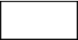



flowchart elements
start / end of program​ | ​
statement​ | ​
conditional | ​
input / output​ | ​
flow of execution | ​
node​ | ​

Slide 24
Bob’s program as a flowchart

Slide 25
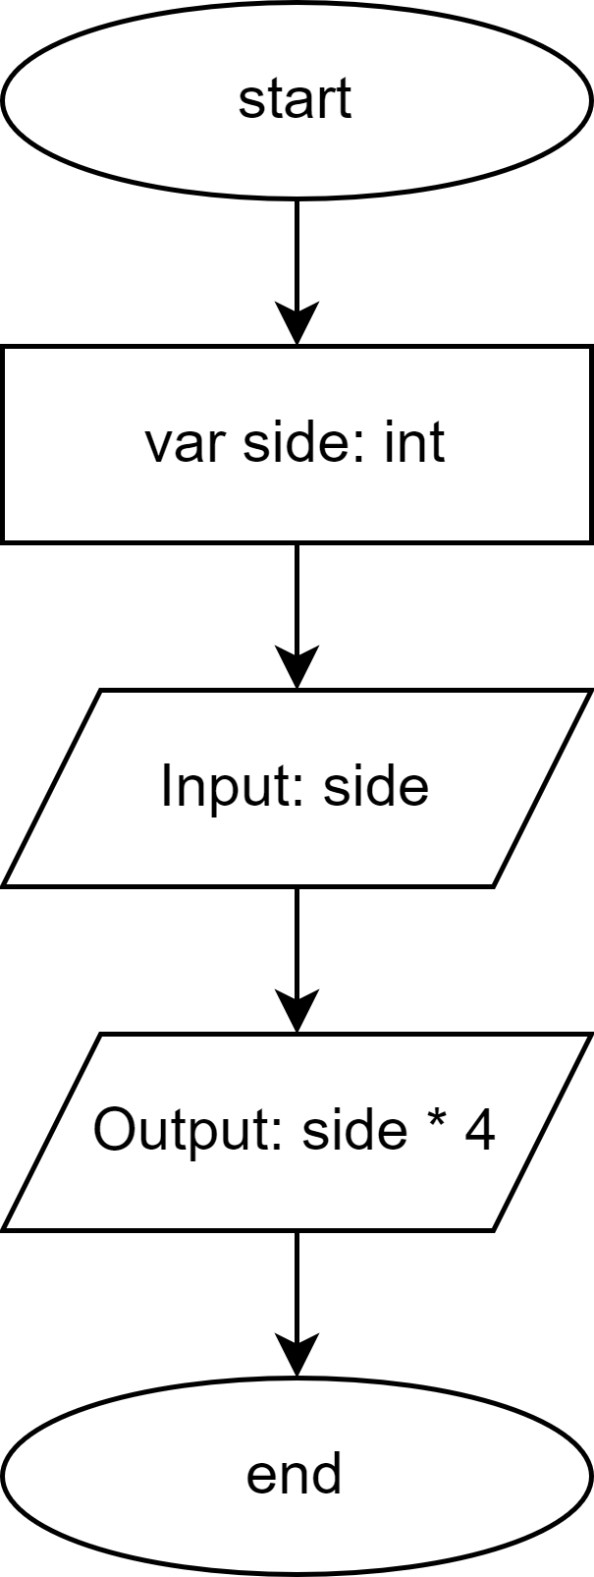

Slide 26
age verification problem

Slide 27

Notes:
explanation

Slide 28
conditionals
or in other words, decision-making
Notes:
often used technique in programming
we want the program to do something based on a … [see next slide]

Slide 29
yes / no questions
Notes:
conditionals
can you give me some examples?

Slide 30
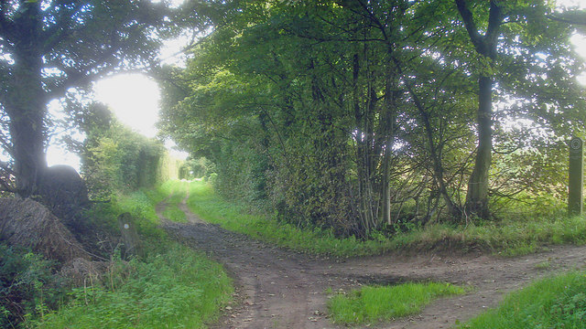
Notes:
it’s like a junction
but in the end, both paths lead to the same place you just see some stuff you wouldn’t otherwise

Slide 31
current_age >= 18
Notes:
can you think of a number where this expression is True and False as well?
no because these are MUTUALLY EXCLUSIV
E
also called boolean expression

Slide 32
time to code

Slide 33
input
output
Notes:
how does this work for our program?

Slide 34
our program
age of user
result
Notes:
result = PASS / FAIL

Slide 35
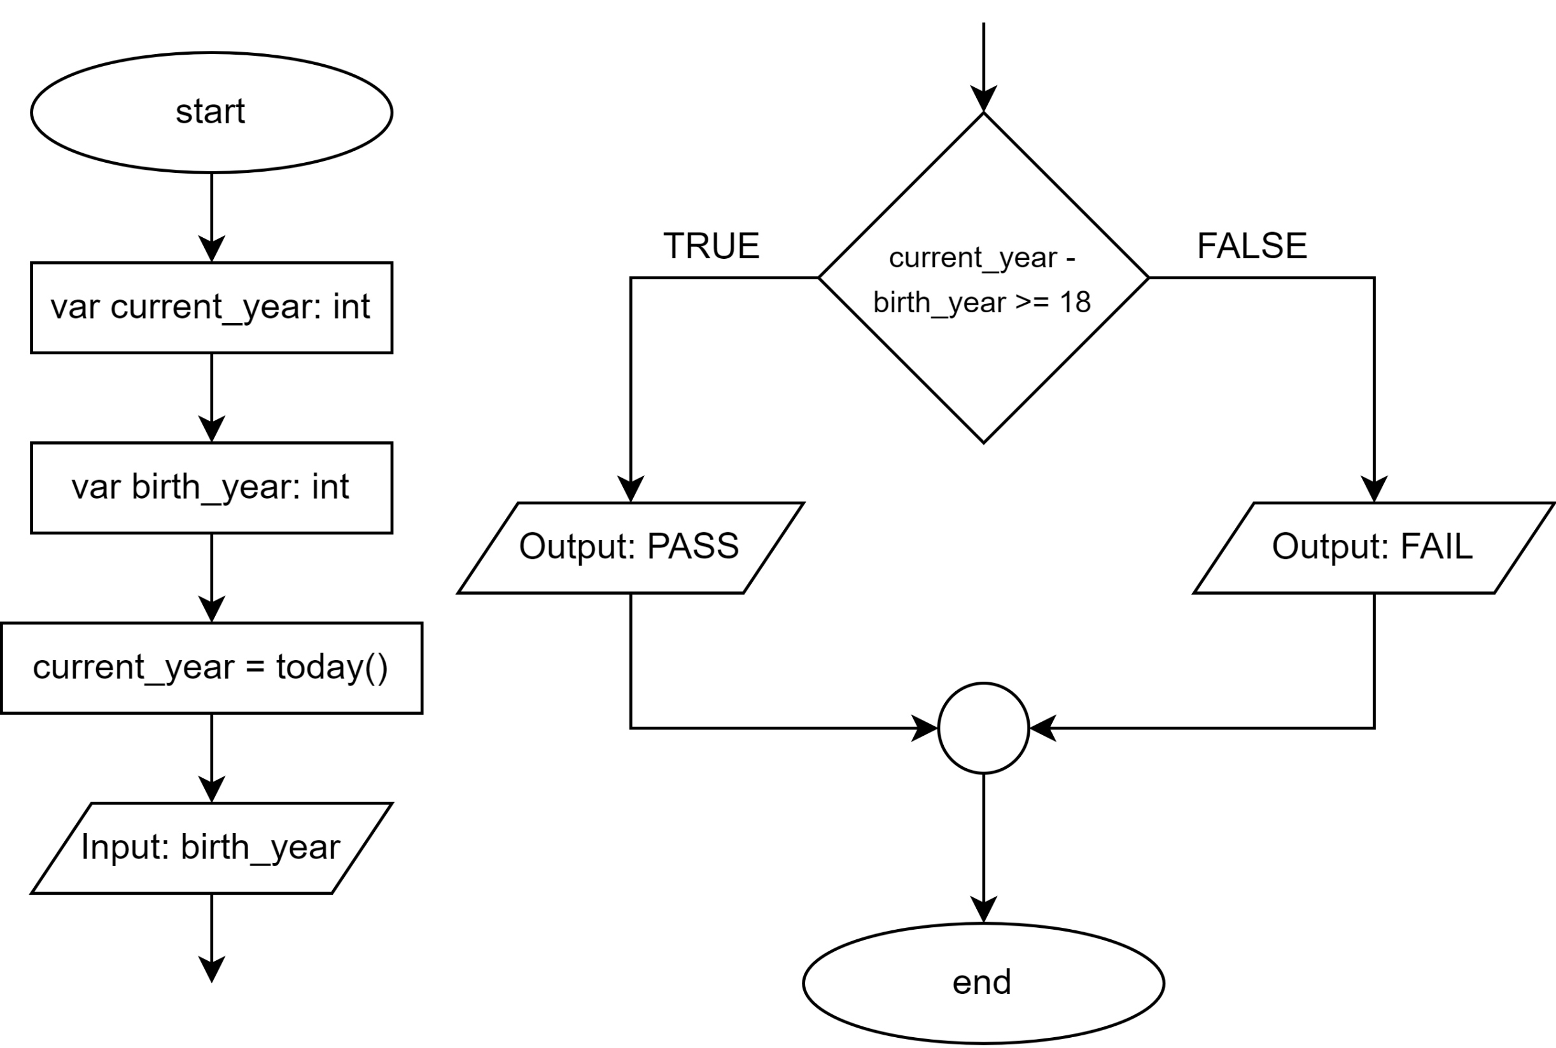
Notes:
guess / draw that

Slide 36
import datetime
Notes:
how do we access the current date?

Slide 37

VARIABLES
color
name
age
…
FUNCTIONS
bark()
play()
pee()
…
Notes:
variables = attributes
functions = methods
we call these OBJECTS

Slide 38
VARIABLES
year
month
day
…
FUNCTIONS
today()
fromtimestamp()
weekday()
…
datetime.date
(date object)

Slide 39
VARIABLES
year
month
day
…
FUNCTIONS
today()
fromtimestamp()
weekday()
…
datetime.date
(date object)

Slide 40
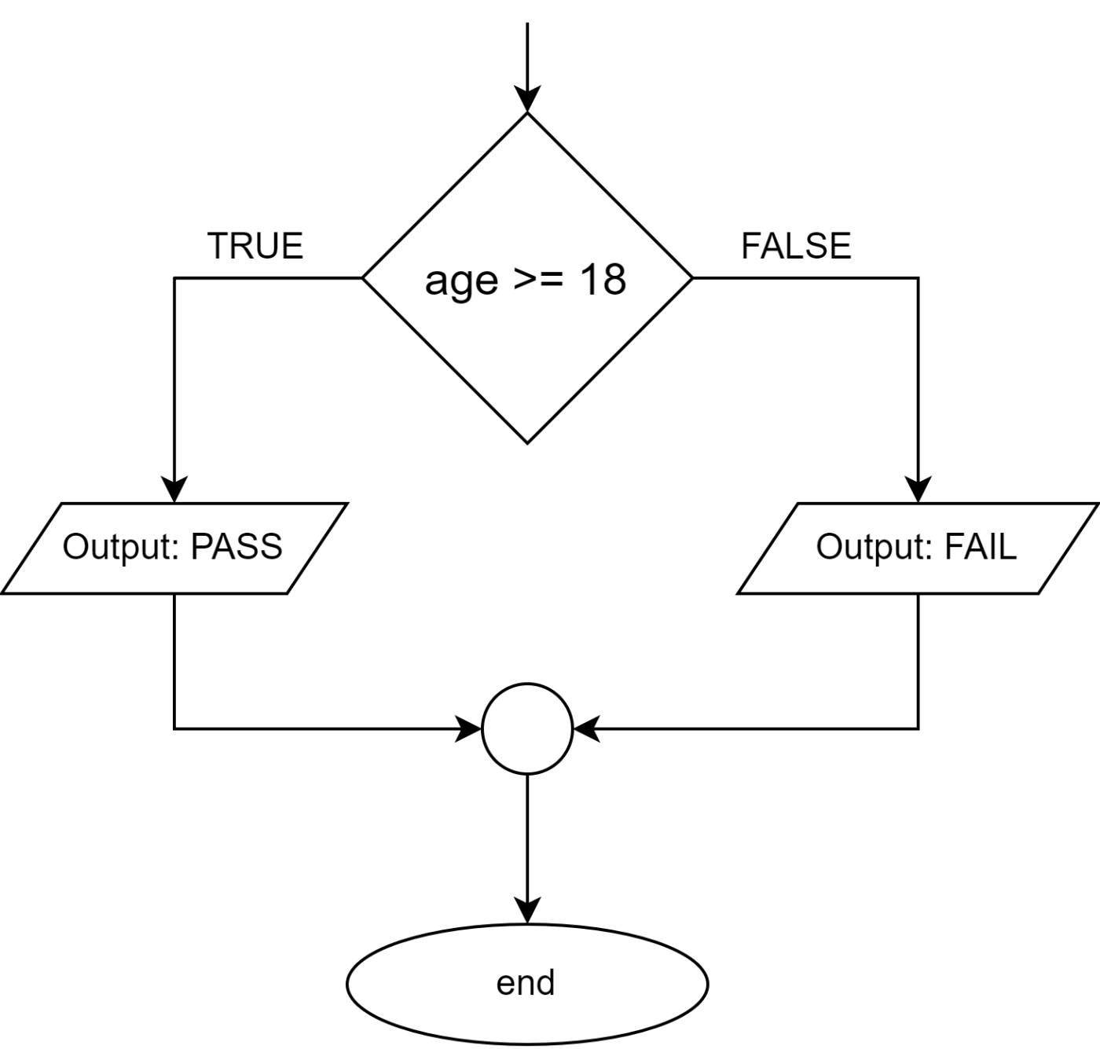
if age >= 18:
print("PASS")
else:
print("FAIL")
Notes:
if-else in python

Slide 41
what we learned today
logic
yes / no questions (boolean expressions)
conditionals (decision-making)
introduction to dates and objects in python

Slide 42
next time
RNG, simulating dice roll
testing, thinking outside the box
preparing for the worst 🫠
making a small RNG-based game
… and much more!

Slide 43
Sources
Aristotle: https://www.britannica.com/biography/Aristotle. Downloaded on 21 April 2023.
Credit Card terminal: https://pixabay.com/vectors/payment-pos-machine-purchase-5695697/. Downloaded on 21 April 2023.
Dog: https://pixabay.com/photos/dog-view-cute-animal-portrait-eyes-838281/. Downloaded on 26 April 2023.
Junction: https://commons.wikimedia.org/wiki/File:Path_junction_in_Old_Parks_Farm_Wood_-_geograph.org.uk_-_1478834.jpg. Downloaded on 21 April 2023.
What: https://i.giphy.com/media/l3q2K5jinAlChoCLS/giphy.gif. Downloaded on 26 April 2023.

